Slide 2
Justice,
Uniqueness,
Kindness,
Equality,
Respect,
Acceptance
Forgiveness
Our school
values.
Inspire today, to shape tomorrow. Our school vision.

Slide 3
Our school bible quote and our values
‘Do not change yourselves to be like the people of this world but be changed to a new way of thinking.
Then you will be able to decide what God wants for
you and you will know what is good and pleasing to
God.’
Romans 12:2

Slide 4
‘Do not change yourselves to be like the people of this world but be changed to a new way of thinking.
Then you will be able to decide what God wants for you and you will know what is good and pleasing to God.’
Romans 12:2

Slide 5
Our values and Bible quotes
Uniqueness | ‘I praise you because I am fearfully and wonderfully made’ (Psalm 139)
Justice | Do not pervert justice; do not show partiality to the poor or favouritism to the great, but judge your neighbour fairly. (Leviticus 19: 15)
Kindness & Forgiveness | Be kind and compassionate to one another, forgiving each other, just as in Christ, God forgave you. (Ephesians 4)
Respect | You shall love your neighbour as yourself. (Matthew 22:39)
Acceptance | Do not mistreat foreigners living in your country. Treat them just as you would treat your own citizens. (Leviticus 19:33)
Equality | There is no difference between Jews and Gentiles, between slaves and free people, between men and women; you are all one in union with Christ Jesus. (Galatians 3:28)

Slide 6
Justice
Do not pervert justice; do not show partiality to the poor or favouritism to the great, but judge your neighbour fairly. (Leviticus 19: 15)

Slide 7
Justice helps us figure out what is fair, what is right and what is wrong.
Justice
Pervert: to cause to turn away from what is good or true or right
Do not pervert justice; do not show partiality to the poor or favouritism to the great, but judge your neighbour fairly. (Leviticus 19: 15)
partiality:
bias or favouritism

Slide 8
Uniqueness
‘I praise you because I am fearfully and wonderfully made’ (Psalm 139)

Slide 9
Uniqueness
‘I praise you because I am fearfully and wonderfully made’ (Psalm 139)

Slide 10
Kindness
Forgiveness
Be kind and compassionate to one another, forgiving each other, just as in Christ, God forgave you. (Ephesians 4)

Slide 11
Kindness
Forgiveness
Be kind and compassionate to one another, forgiving each other, just as in Christ, God forgave you. (Ephesians 4)

Slide 12
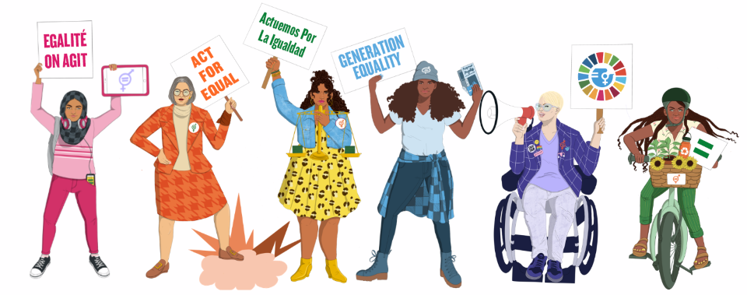
Equality
There is no difference between Jews and Gentiles, between slaves and free people, between men and women; you are all one in union with Christ Jesus. (Galatians 3:28)

Slide 13
Equality
There is no difference between Jews and Gentiles, between slaves and free people, between men and women; you are all one in union with Christ Jesus. (Galatians 3:28)

Slide 14
Respect
You shall love your neighbour as yourself. (Matthew 22:39)

Slide 15
Respect
You shall love your neighbour as yourself. (Matthew 22:39)

Slide 16
Acceptance
Do not mistreat foreigners living in your country. Treat them just as you would treat your own citizens. (Leviticus 19:33)

Slide 17
Acceptance
Do not mistreat foreigners living in your country. Treat them just as you would treat your own citizens. (Leviticus 19:33)

Slide 18
‘Do not change yourselves to be like the people of this world but be changed to a new way of thinking. Then you will be able to decide what God wants for you and you will know what is good and pleasing to God.’ Romans 12:2
Justice
Do not pervert justice; do not show partiality to the poor or favouritism to the great, but judge your neighbour fairly. (Leviticus 19: 15)
Kindness
Forgiveness
Be kind and compassionate to one another, forgiving each other, just as in Christ, God forgave you. (Ephesians 4)
Uniqueness
‘I praise you because I am fearfully and wonderfully made’ (Psalm 139)
Equality
Acceptance
There is no difference between Jews and Gentiles, between slaves and free people, between men and women; you are all one in union with Christ Jesus. (Galatians 3:28)
Respect
Do not mistreat foreigners living in your country. Treat them just as you would treat your own citizens. (Leviticus 19:33)
You shall love your neighbour as yourself. (Matthew 22:39)

